Slide 1
Math 152 – Lesson 14
Lesson | Topic | Reading
13 | Integration of Rational Functions by Partial Fractions | 7.4
14 | Improper Integrals | 7.8
15/16 | Work/Ave Value of a Function | 6.4/6.5
Objectives:
Determine if an integral is improper (Type I or II)
Evaluate an improper integral as a limit of proper integrals
Determine convergence of an improper integral
Notes:
Previously looked at integrals over a finite interval of a function that did not have an infinite discontinuity
IMPROPER integral:
Interval is infinite, or
Has an infinite discontinuity

Slide 2

Improper Integrals
An integral is proper if:
Finite interval
No discontinuities over that interval
An integral is improper if:
Interval is infinite
Has an infinite discontinuity
Look at two types of improper integrals:
Infinite integrals
Discontinuous integrals
Don’t Panic!
Don’t make this harder than it is ☺

Slide 3
Type 1: Infinite Intervals
Given y = 1/x², does it converge or diverge between the range of [1,inf)?
Does infinite limits of integration always mean infinite area?
Figure 1

Slide 4
Type 1: Infinite Intervals
Instead of looking at infinity, look at the area under the curve for a specific range

Slide 5
Type 1: Infinite Intervals
Notice that A(t) < 1 no matter how large t is chosen. We also observe that
The area of the shaded region approaches 1 as t →
Figure 2

Slide 6
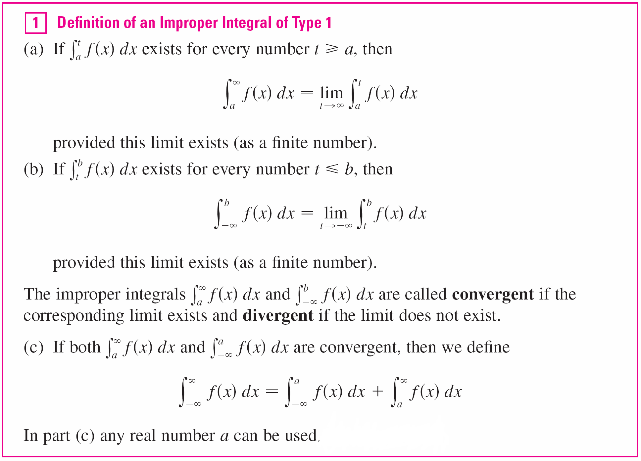
Type 1: Infinite Intervals

Slide 7
Type 1: Infinite Intervals
Determine whether the integral is convergent or divergent.
Solution: According to part (a) of Definition 1, we have
The limit does not exist as a finite number and so the improper integral is divergent.

Slide 8
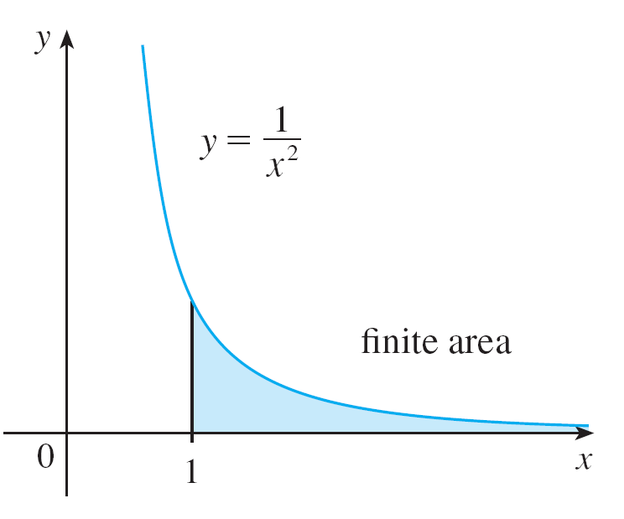


Type 1: Infinite Intervals

Slide 9
Type 2: Discontinuous Integrals
Find
Solution:
We note first that the given integral is improper because it has the vertical asymptote x = 2.

Slide 10
Type 2: Discontinuous Integrals

Slide 11
Type 2: Discontinuous Integrals
Since the infinite discontinuity occurs at the left endpoint of [2, 5], we use part (b) of Definition 3:
The given improper integral is convergent

Slide 12
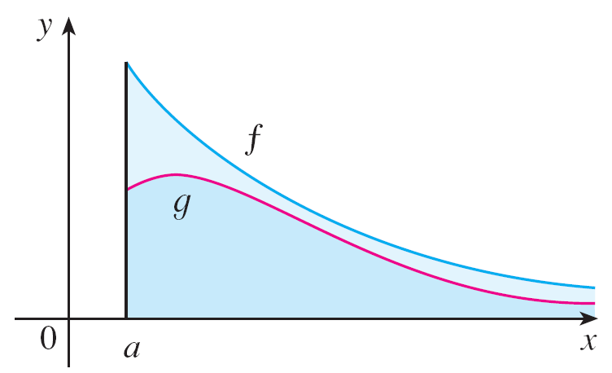
Comparison Test for Improper Integrals
Another way to determine convergence/divergence is the comparison test
If the area under the top curve f (x) is finite, then so is the area under the bottom curve g (x).
Figure 12

Slide 13
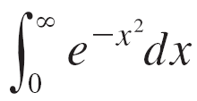
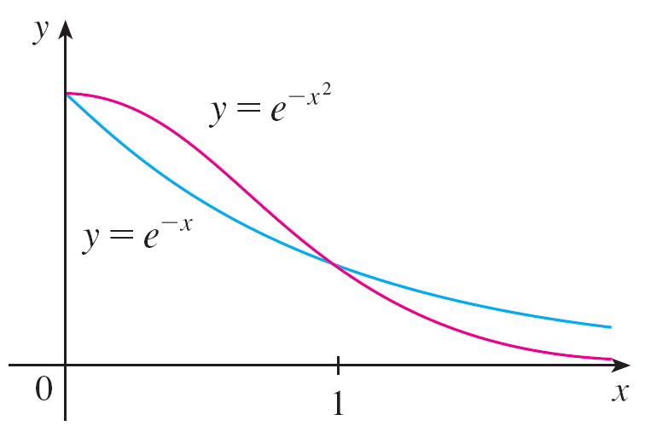
Comparison Test
Show that is convergent.
Solution:
We can’t evaluate the integral directly and need to find an equation that encapsulates it
[0,1]
Finite Area

Slide 14
Comparison Test
Now switch to the larger integral, e^{–x}, and evaluate it instead:
convergent
Figure 13

Slide 16
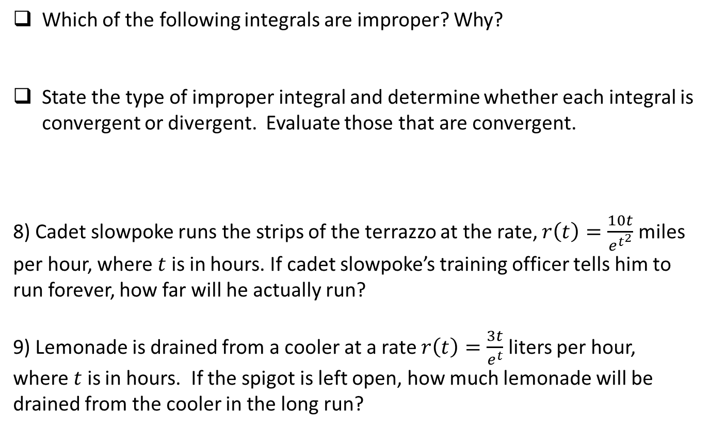
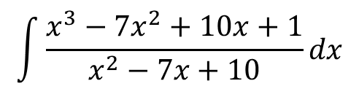
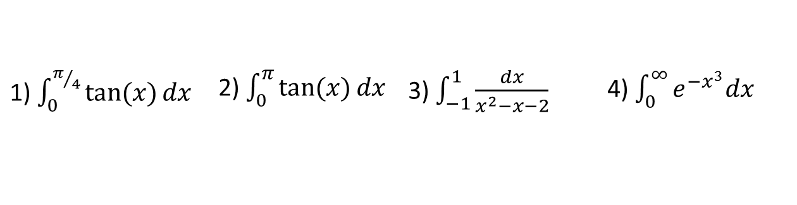
Board Work
Which of the following integrals are improper? Why?
State the type of improper integral and determine whether each integral is convergent or divergent. Evaluate those that are convergent.
8) Cadet slowpoke runs the strips of the terrazzo at the rate, $r\left(t\right)=\frac{10t}{e^{t^{2}}}$ miles per hour, where $t$ is in hours. If cadet slowpoke’s training officer tells him to run forever, how far will he actually run?
9) Lemonade is drained from a cooler at a rate $r\left(t\right)=\frac{3t}{e^{t}}$ liters per hour, where $t$ is in hours. If the spigot is left open, how much lemonade will be drained from the cooler in the long run?
1) $\int_{0}^{π/4}{\tan{(x)}dx}$ | 2) $\int_{0}^{π}{\tan{(x)}dx}$ | 3) $\int_{−1}^{1}{\frac{dx}{x^{2}−x−2}}$ | 4) $\int_{0}^{∞}{e^{{−x}^{3}}dx}$
5) $\int_{−∞}^{0}{\frac{1}{3−4x}dx}$ | 6) $\int_{2}^{∞}{\frac{dv}{v^{2}+2v−3}}$ | 7) $\int_{2}^{3}{\frac{1}{\sqrt{3−x}}dx}$
Notes:
Proper
Infinite Discontinuity @ pi/2
Infinite Discontinuity @ -1
Infinite limit of integration
(7.8, #7) Type-I: infinite limit of integration, divergent (7.8, #7)
(7,8 #18) Type-I: infinite limit of integration (note (v-1)(v+3) = 0 @ v=1 & v=3…but outside limits of integration. = Ln(5)/4
Type-II: at x = 3. = 2
5
Ln(2)

